Slide 1
Food Classification
Mengting Xu, Jeff Yeh

Slide 2
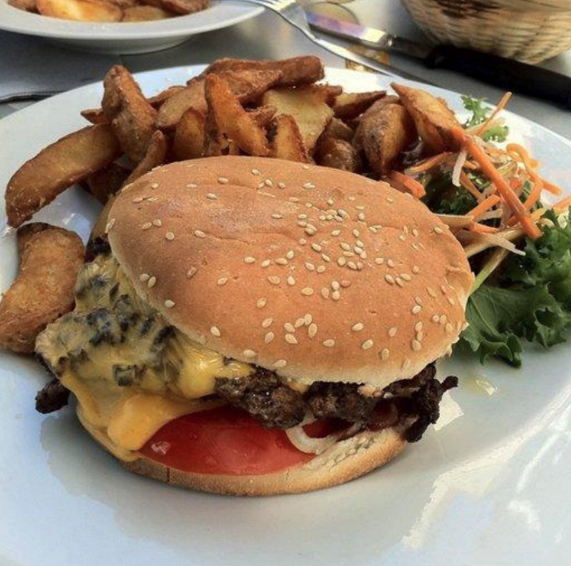
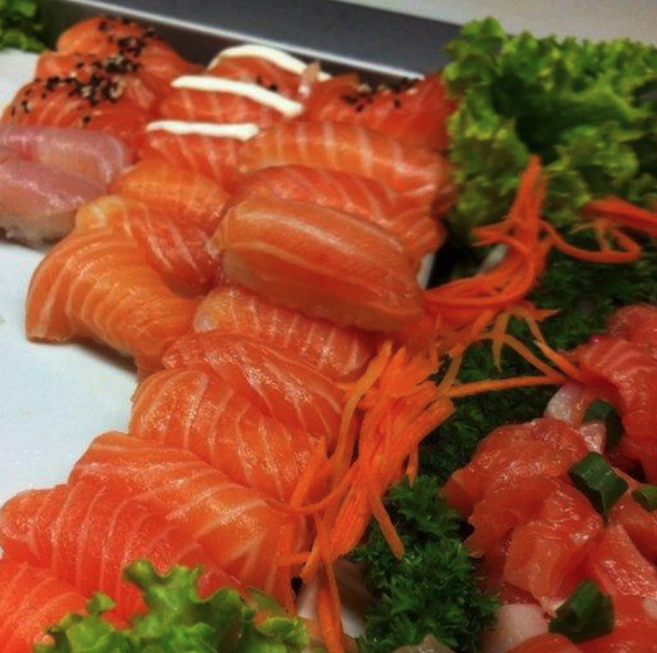
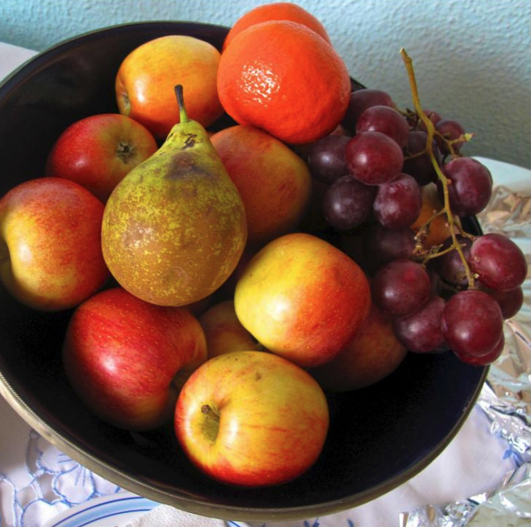
Goal
In this project, we aim to build up several DL models to classify food images into the 11 categories with at least 80% accuracy.

Slide 3
Dataset
Source
Introduction
The dataset was collected from Kaggle’s Food-11 image dataset
Training set: 280*11 labeled images + 6786 unlabeled images
Validation set: 60*11 labeled images
Testing set: 3347 images

Slide 4
Experiment Process
Based Models
W/O
Semi Supervised
Advanced Models
W/O
Semi Supervised
Pretrained Models
W/O
Semi Supervised

Slide 5
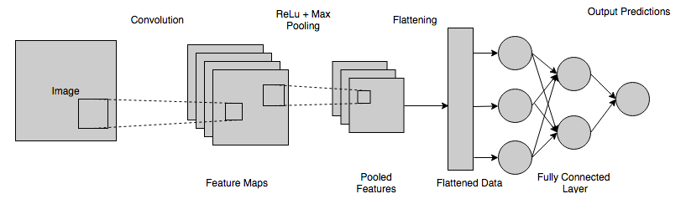
Base Model

Slide 6
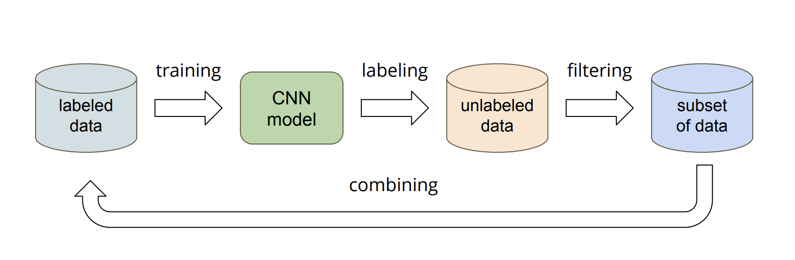
Semi-Supervised Learning
Threshold
0.6
0.9

Slide 7
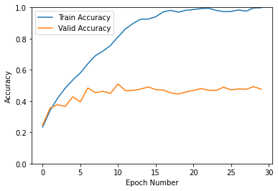
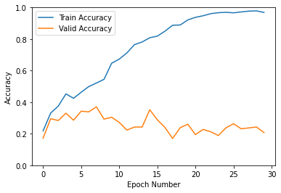
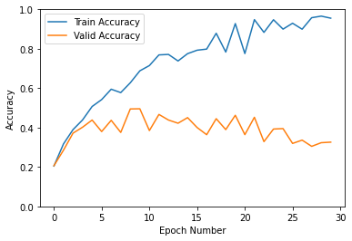
Base Model Performance
OVERFITTING!!!
Based Model without Semi-supervised
Test Set Acc: 0.495
Based Model with Semi-supervised
Threshold: 0.6
Test Set Acc: 0.214
Based Model with Semi-supervised
Threshold: 0.9
Test Set Acc: 0.318

Slide 8
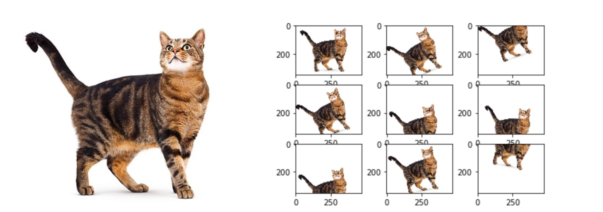
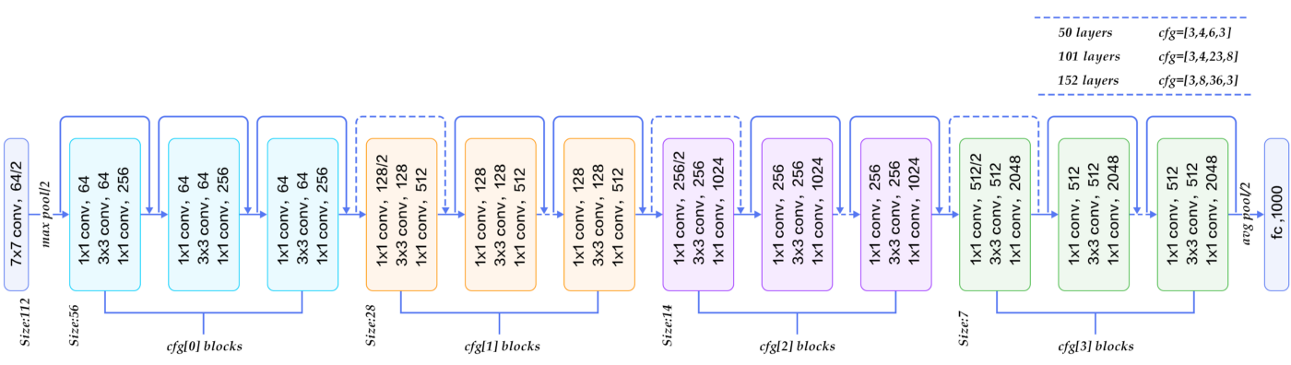
Advanced Model
ResNet-18
Augmentation

Slide 9
Augmentation
Random Resize
Crop
Random Rotation
Random Horizontal Flip
Center Crop

Slide 10
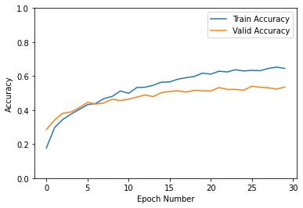
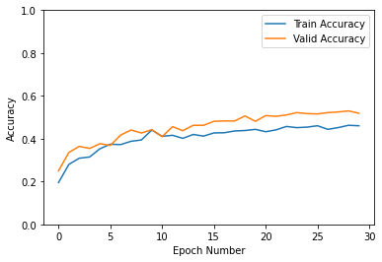
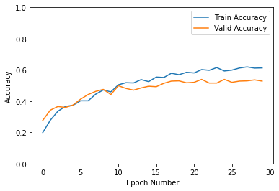
Advanced Model Performance
Advanced Model without Semi-supervised
Test Set Acc:0.547
Advanced Model with Semi-supervised
Threshold: 0.6
Test Set Acc:0.501
Advanced Model with Semi-supervised
Threshold: 0.9
Test Set Acc:0.52
Notes:
Semi 0.6更爛

Slide 11
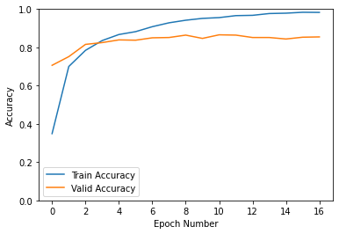
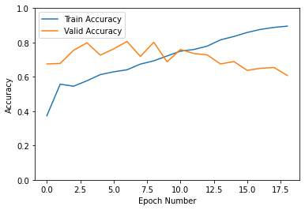
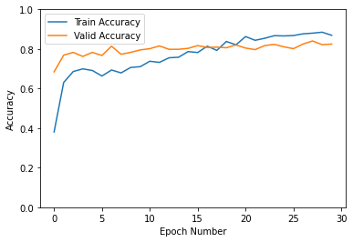
Pretrained Model Performance
Pretrained Model without Semi-supervised
Test Set Acc:0.851
Pretrained Model with Semi-supervised
Threshold: 0.6
Test Set Acc:0.545
Pretrained Model with Semi-supervised
Threshold: 0.9
Test Set Acc:0.81
Notes:
Pretrained 不用semi是更好的 -> 不用 data semi

Slide 12
Conclusion
What went well:
Building a basic model is important. It helps us recognize vanilla CNN result in serious over-fitting, and we need a new deep learning structure.
It is essential to stand upon the shoulders of giants, so we learn from other’s experience to apply Resnet-18 as our advanced model. (Pretrained is the best!!!)
What didn’t go well:
Semi - Supervised aims to improve the model performance when we don’t have enough training data, but we didn’t observe its power in the three experiments we made.
If we were to continue to work on this project, we think we could tune the batch size, learning rate, dropout rate, etc.

Slide 13
Thank you
Notes:
“How does deep learning used in this project?” and “Where am I going to get the data for this project?”

